Slide 1
Dashboard Idea’s and suggestions:
What are you trying to tell? Visualize how different features impact the popularity of a song
Summary data: Number of song with Percent of total, average score of the most important features with percent of max.
Trends over the decades: bar chart of the number of popular song per decade with to trend lines showing the average score for the popular songs and the unpopular songs.
Additional information: Chart listing all the measured features and indicate their relative importance
Dashboard interaction: User can select on the Summary information: (popular / unpopular) as well as the decade, with possible additional option.
Dashboard interaction: Users selects the feature and the trend section and the two chart will pull in the average score for the popular songs and the un-popular song to compare.
This dashboard will be created using an excel file with Tableau.

Slide 2
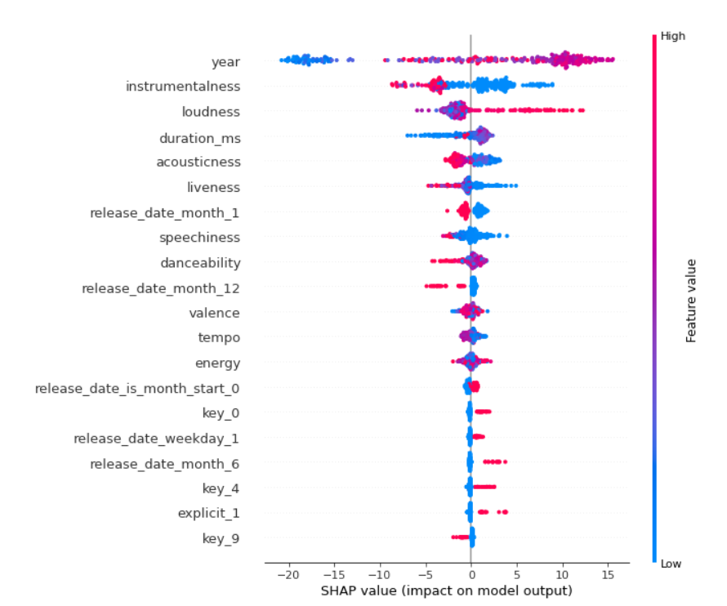
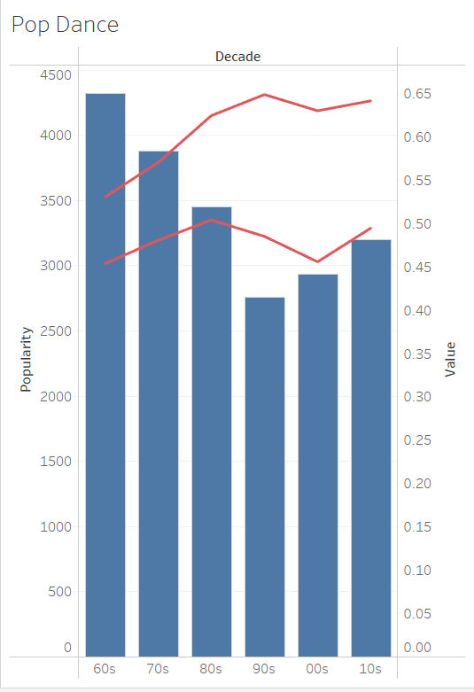
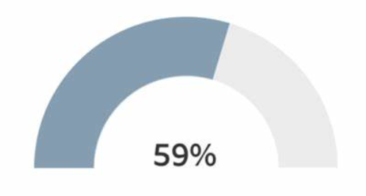
Popular / Non-Popular
Measured Feature
Decade
Other
4,321
Number Songs
i
.5306
.5306
Acoustics avg
Danceability avg
.6552
.6552
Energy avg
Instramentality avg

Slide 3
Popular / Non-Popular
.5306
.5306
Decade
Acoustics avg
Danceability avg
4,321
Other
Number Songs
.6552
.6552
Energy avg
Instramentality avg
Measured Feature
Measured Feature

